Slide 1
VP160 Recitation Class 2
by Li Chunchao
2016/5/31

Slide 2
Short Review

Slide 3

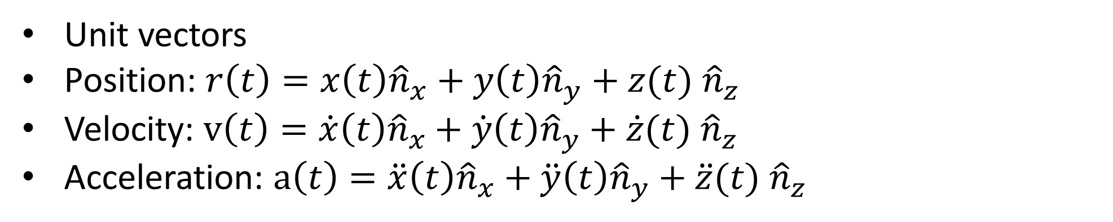
Cartesian coordinates
Unit vectors
Position: $r\left(t\right)=x\left(t\right){\hat{n}}_{x}+y\left(t\right){\hat{n}}_{y}+z(t) {\hat{n}}_{z}$
Velocity: $v\left(t\right)=\dot{x}\left(t\right){\hat{n}}_{x}+\dot{y}\left(t\right){\hat{n}}_{y}+\dot{z}(t) {\hat{n}}_{z}$
Acceleration: $a\left(t\right)=\ddot{x}\left(t\right){\hat{n}}_{x}+\ddot{y}\left(t\right){\hat{n}}_{y}+\ddot{z}(t) {\hat{n}}_{z}$

Slide 4
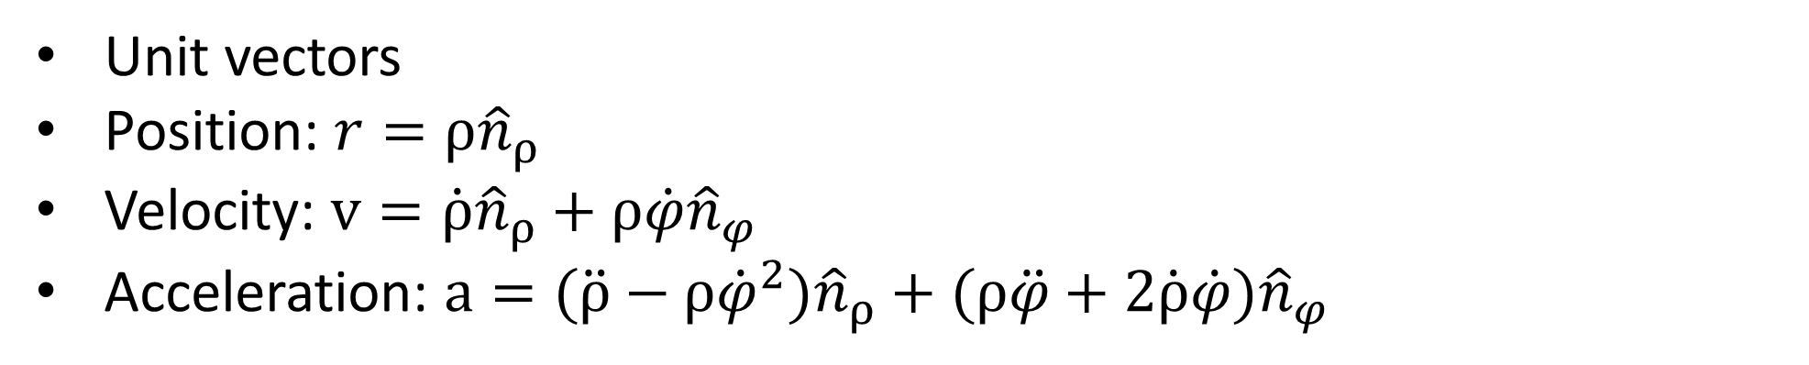
Polar coordinates
Unit vectors
Position: $r=ρ{\hat{n}}_{ρ}$
Velocity: $v=\dot{ρ}{\hat{n}}_{ρ}+ρ\dot{φ}{\hat{n}}_{φ}$
Acceleration: $a=(\ddot{ρ}−ρ{\dot{φ}}^{2}{)\hat{n}}_{ρ}+(ρ\ddot{φ}+2\dot{ρ}\dot{φ}){\hat{n}}_{φ}$

Slide 5
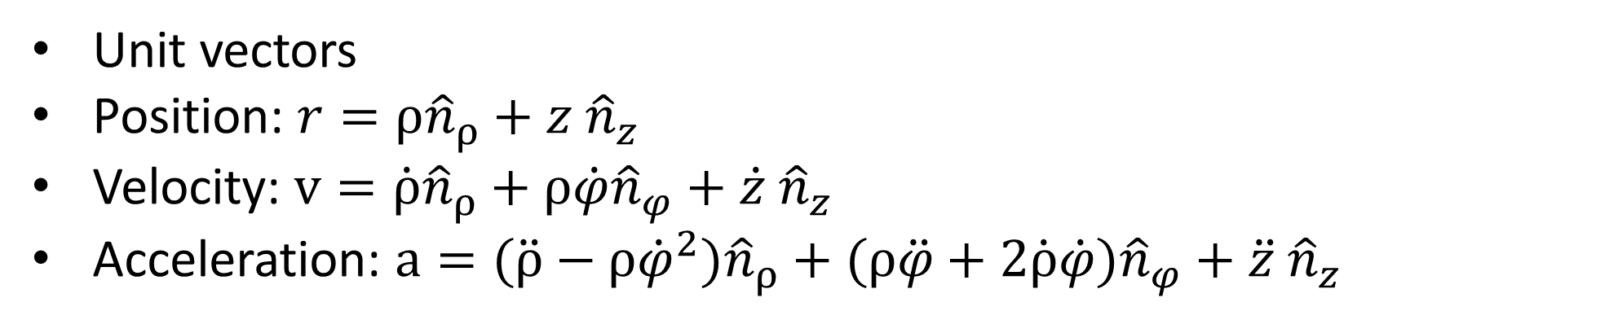
Cylindrical coordinates
Unit vectors
Position: $r=ρ{\hat{n}}_{ρ}+z {\hat{n}}_{z}$
Velocity: $v=\dot{ρ}{\hat{n}}_{ρ}+ρ\dot{φ}{\hat{n}}_{φ}+\dot{z} {\hat{n}}_{z}$
Acceleration: $a=(\ddot{ρ}−ρ{\dot{φ}}^{2}{)\hat{n}}_{ρ}+(ρ\ddot{φ}+2\dot{ρ}\dot{φ}){\hat{n}}_{φ}+\ddot{z} {\hat{n}}_{z}$

Slide 6
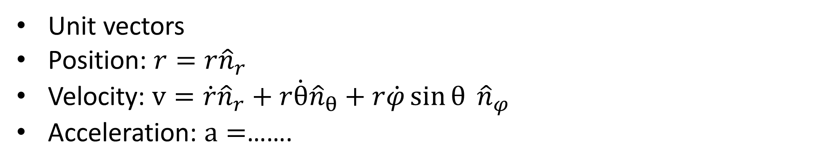
Spherical coordinates
Unit vectors
Position: $r=r{\hat{n}}_{r}$
Velocity: $v=\dot{r}{\hat{n}}_{r}+r\dot{θ}{\hat{n}}_{θ}+r\dot{φ}\sin{θ} {\hat{n}}_{φ}$
Acceleration: $a=$…….

Slide 7
Natural coordinates
Choice of unit vectors
Radial/transversal
Normal/tangential
Curvature

Slide 8
Solving Problems

Slide 9
Kinematics
To perform a clean shot, a basketball player needs to adjust the throwing angle and initial speed of the ball. Find the relationship between the throwing angle and initial speed. We know the height difference between the hand and the basket is h; the horizontal distance between the hand and the basket is s.

Slide 10
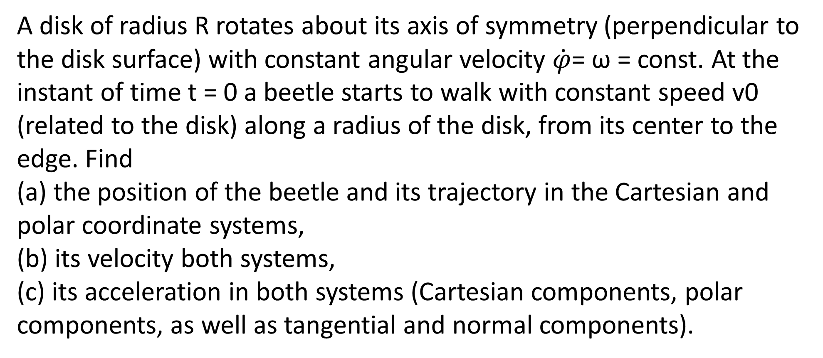
Kinematics
A disk of radius R rotates about its axis of symmetry (perpendicular to the disk surface) with constant angular velocity $\dot{φ}$= ω = const. At the instant of time t = 0 a beetle starts to walk with constant speed v0 (related to the disk) along a radius of the disk, from its center to the edge. Find
(a) the position of the beetle and its trajectory in the Cartesian and polar coordinate systems,
(b) its velocity both systems,
(c) its acceleration in both systems (Cartesian components, polar components, as well as tangential and normal components).

Slide 11
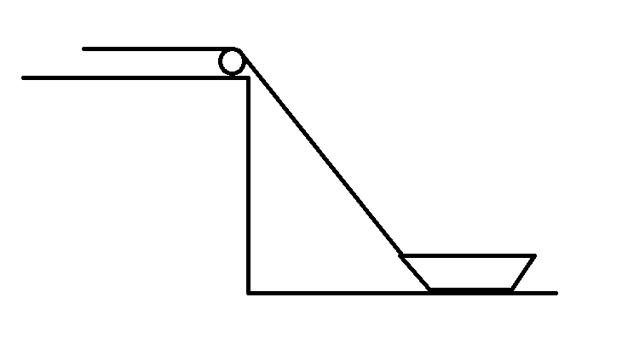
Kinematics
A man is pulling a ship by a rope with the speed v, the angle between rope and water surface is θ, find the speed of the ship

Slide 12
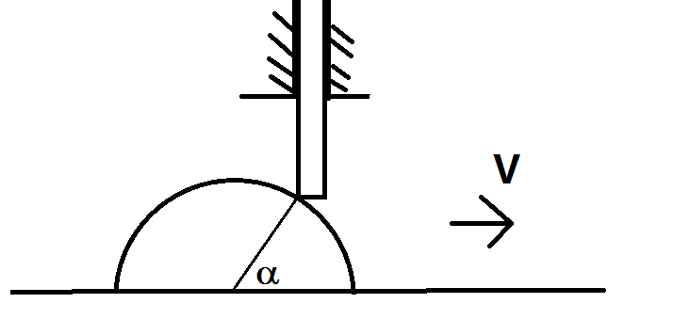
Kinematics
A stick can only move up and down, a semicylinder move below the stick with speed v, we know the angle α, find the speed of the stick.

Slide 13
Kinematics
Four spiders are initially placed at the four corners of a square with side length l. The spiders crawl counter-clockwise at the same speed v and each spider crawls directly toward the next spider at all times. They approach the center of the square along spiral paths. Find
(a) the time after which all spiders meet,
(b) polar coordinates of a spider at any instant of time, assuming the origin is at the center of the square.
(c) the trajectory of a spider in polar coordinates.

Slide 14
Kinematics
What about three spiders on a equilateral triangle?

